Slide 1
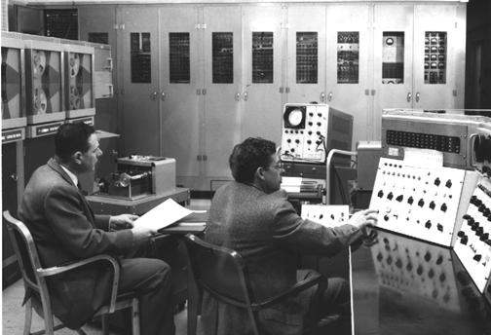
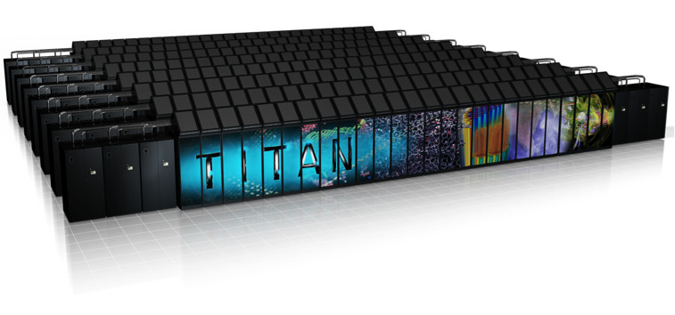
National Strategic Computing Initiative at NIST
Algorithms, Architectures and Applications
Ronald F. Boisvert
Information Technology Laboratory
Notes:
16:9 aspect ratio, scaled in PowerPoint to 13.33” x 7.5”. 144 dpi for HD 1920 x 1080 projectors.
Photos are 360 x 270 pixels, 144 dpi, 2.5” x 1.875”, 8 pt soft edges in PowerPoint (needed for 18 pt, 0.125” overlap)
Vertical offsets of photos: 0.38”, 2.13”, 3.88”, 5.63” (.125” overlap);
Horizontal offsets of photos: 8.46”, 10.83” (0.11” overlap)

Slide 2
Outline
Context: NSCI Strategic Plan
Planned / Potential Focus Areas for NIST
with brief assessment of current capabilities
Current Example: Enabling Technologies for Data Analytics

Slide 3
Context
NSCI Strategic Objective 4*: An Enduring National HPC Ecosystem
Increasing the capacity and capability of an enduring national HPC ecosystem by employing a holistic approach that addresses relevant factors such as
networking technology
workflow
downward scaling
foundational algorithms and software
accessibility, and
workforce development.
“easily accessible to and usable by the broadest range of researchers”
* NSCI Strategic Plan, White House, July 2016

Slide 4
Diving Deeper into the NSCI Plan
NSF, NIST, and DOE share leadership for algorithm development, … supplemented by research … by deployment agencies for … mission needs.
NSF, NIST, and IARPA will lead networking R&D … to increase access to capable exascale systems.
Beyond specific agency plans ..., future areas of focus for NSCI agencies may include research, development, and deployment of
Innovative, verifiable, scalable, and reusable application software components,
Integrated security capabilities that address the unique aspects of HPC
Privacy and management controls that address the velocity and data aggregation challenges presented by emerging datasets and converged HPC technologies
Robust, secure, and high-performing network fabrics
Next-generation comprehensive cybersecurity and cyber resiliency solutions

Slide 5
Plans: Reliability of HPC Applications
Dealing with increasing lack of inherent hardware resilience
Enabling trust/confidence in computed results
Need
Approach
Characterizing faults, resilient algorithms, programming tools
Metrology for scientific computing: uncertainty quantification (UQ) methodology, benchmarks, standard reference simulations
Current
Numerical Reproducibility at Exascale Workshop (SC15, 16)
MGI: Workshop on UQ in Materials Science, Jan. 14-15, 2016
MGI: Validation of DFT; UQ for molecular dynamics (w/Boeing)
Measurement foundations for terascale imaging

Slide 6
Plans: High Performance Networks
New network technologies at a range of scales: networks on chips (NoC), data center interconnects, the global internet
Need
Evaluate NoC, software-defined interconnection networks, information-centric networking: modeling & simulation
Develop measurement probes, collection and analysis systems, to instrument, profile, and analyze network performance
Approach
Current
Modeling of faults in complex networks
Studies of software-defined networks
NIST Cloud Computing Program

Slide 7
Plans: Cybersecurity for NextGen Systems
Security by design, not bolted on as afterthought
Need
Raise awareness, evaluate options, establish guidelines
Hardware roots of trust
Compositions of tailored, confined execution environments
Undetectable layers of virtualization
Synthetic software diversity
Approach
Current
High Performance Computing Security Workshop, Gaithersburg, September 28-29, 2016
https://www.nist.gov/news-events/events/2016/09/nsci-high-performance-computing-security-workshop

Slide 8
Plans: Big Data Ecosystem
Standardized architectures, frameworks for workflows
Metadata standards for data provenance, quality
Standard vocabularies for data interchange
Need
Approach
Community-based standards activities
Development of supporting tools
Current
NIST Big Data Interoperability Framework
Definitions, use cases, security & privacy, reference architecture
MGI: Materials Data Curation System, Resource Registry

Slide 9
Plans: Computing Facilities Access
First-hand experience, with emerging architectures, systems
Increased capability, capacity for NIST measurement applications
Modeling of new material/device technologies
Development of UQ technologies, benchmarks, reference simulations
Need
Approach
Alliances with other government agencies
Wider variety of local mid-range resources
Current
Ad hoc allocations on DOE INCITE, NSF XSEDE
Some expertise within ITL HPC & Visualization Group, others

Slide 10
Example Effort: Data Science Evaluation
Drive improvements in understanding, reliability, performance of data analytics tasks by enabling community-wide measurement, analysis
Data Science Evaluation Series (DSE)
Annual evaluation to measure performance on general-purpose data analytic tasks in context of multiple use cases/applications
Evaluation Management System (EMS)
Reconfigurable high-performance cloud-based evaluation infrastructure for data analytic benchmarking for multiple algorithms, computing platforms
Community-wide Participation
Common-metrics
Cloud-based infrastructure
Efficient data access, while ensuring data protection and reusability

Slide 11
Evaluation-Driven Research Paradigm
Data Generated or collected to support the representative task
Planning Define a representative task
In-Domain Researchers core technology development
Performance on EMS Metrics measure error and system performance
Analysis and workshop
Open forum to share research findings
This NIST approach has led to advances in text retrieval, speech, language, video processing

Slide 12
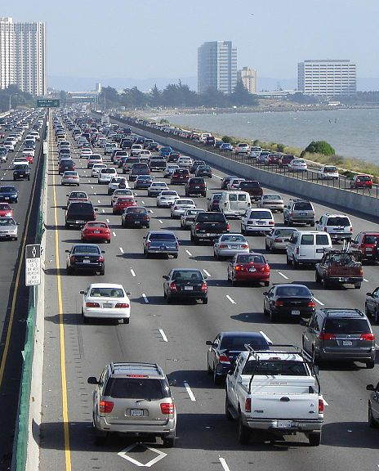
Data Science Evaluation 2016 Pilot
Focused on traffic analysis
Data provided by UMD CATT Lab and DC/MD/VA DOTs
250 GB traffic sensor data (number of vehicles, speed, lanes)
10 TB traffic video data
Additional data: accidents, construction, lane closures, weather
Tasks
Data cleaning. Issue: ground truth?
Data alignment. Link sensor data with videos (timestamps removed)
Next: Prediction
Nine participating research institutes. Downloading training data now
Next app: remote sensing for vegetation analysis (with UFL)
By User Minesweeper on en.wikipedia

Slide 13
Challenges
NIST not traditionally a center for HPC R&D
Little access to HPC computing resources
Some areas severely under-resourced in context of HPC
Networking
Security
Big data

